Slide 1



Diagnostics Analysis
The Flipcarbon Way!

Slide 2

Diagnostic Approach
Organizational diagnosis explores all levels of an organization, from surface aspects to hidden elements.
It employs structured and unstructured discussions to gather insights.
The goal is to grasp the current state, identify gaps, pinpoint bottlenecks, and determine their causes to inform management's solutions.

Slide 3

Objectives and Coverage
Identify positive drivers of all Business Processes which need attention, to ensure enhanced effectiveness at :-
Organisational Level | To recognize at a top level about how the organisation approaches from strategy to tactical, vision to execution
Team Level | An assortment of resources that are suitable in optimizing the performance at an operational level
16 People were interviewed across all departments to collect valid information about their Function as well as Business Processes + Systems in place, reporting framework, key metrics & SLAs, MIS, management routines etc.

Slide 4




The need for diagnosis?
CURRENT REALITY
ASPIRATIONS
BRIDGING GAPS
Understanding of org health, Process Awareness & Entrenchment
Desired position, business direction and Expected outcome
Leveraging strength, eliminating weakness - designing process and putting it to Practice

Slide 5
Executive Summary
Business Strategy – not articulated, documented and communicated within the organization
Absence of Strategic financial plans and robust AOP process to drive achievement of strategic and annual objectives
Business and Individual Goals, KPIs, Targets not defined and communicated in absence of a robust performance management process
Unoptimized cash flow projections based on unpredictable sales forecasts, demand, and inventory planning
Absence of business process workflow and SLA as well as undefined turnaround time and lack of authority matrix,
Management routines not defined and implemented – Performance reviews not done to drive actionables
Decisions are not data driven – primarily due to lack of well defined MIS, dashboards and data analytics
Lack of robust financial, sales and operating reporting framework
Mentoring and coaching for succession planning

Slide 6
Executive Summary
Data across departments are stored in excel and paper, automation with ERP implementation is the need of the hour!
Highly centralized Organization structure resulting in Blurred reporting lines with overlapping responsibilities.
The organization lacks comprehensive learning and development, focusing solely on sales training. It needs cultural transition training to shift to a ‘performance-driven culture’.
The need for capability transformation is pressing considering the high aspiration of the founders
Continued challenges in Talent acquisition and management
Customer-driven projects, complicating internal processes due to insufficient project costing and management tools
Sales process not aligned efficiently leading to Challenges in customer relationship management, Demo planning impacting revenue and conversions.
High fixed costs resulting in lower net profit margins

Slide 7






Founder’s Aspiration- Financial
The company aims to double its revenue from 26 Crores to 53 Crores this year
To secure 10-20 Crore deals within the next 3 years
Achieve 100 Crore in revenue in 3 years organically without big ticket deals
By March’24, have 2 new T&M products. Innovate new versions of existing T&M products, and emphasize on end to end in house manufacturing
Optimizing indirect cost and cash flow projections

Slide 8





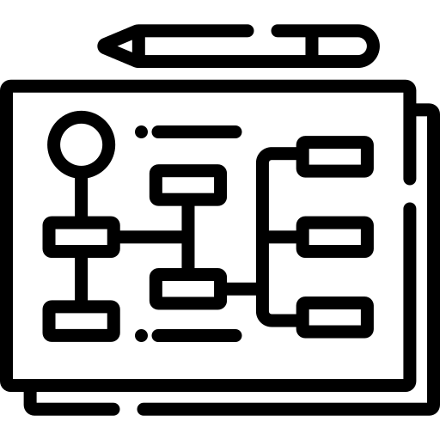
Founder’s Aspiration- Operational
Streamline internal process, systems and reporting framework
Forecasting demands and sales estimation with precision
Optimizing Lead time to deliver big orders
Robust Vendor management policies
Resource mapping

Slide 9

Function wise Diagnosis

Slide 10
Diagnosis
Prognosis
Finance Observation
There is no defined and documented strategy which is communicated across the organization
Proper understanding on V-M-V and its cognizance in organization required
There is no clear 3-5 years revenue plan defined with year-on-year targets
Lack of GTM strategy and org structure to drive business development.
Management understands the importance of Annual Operating plan, however the same has to be optimized, tracked regularly, and entrenched in the operations
Strategic planning with GTM strategy, talent strategy and financial strategy cascading to functional goals and individual goals to ensure people are engaged with it
A strategic planning exercise will lead to Financial planning which can create visibility on Revenues, Profit, cash flows, CAPEX, OPEX & talent requirements
An AOP with the right building block cascading to monthly targets for each function and its alignment to business goals is the key to drive the organization growth.
Strategic & Financial Planning
Annual Operating Plan (AOP)

Slide 11
Diagnosis
Prognosis
Finance Observation
No Updated and optimized Finance SOPs for recording revenue, expenditure, capex, payments, receipts, generation of MIS reports
Top Management is involved in tactical operational activities, approval for which delays the overall processes at various stages
Create a complete finance & accounts framework for record keeping
Create and implement MIS & dashboards with special focus to standard MIS templates.
Financial Management
Optimized Cash Flow Forecasting and management not in place
No proper Wealth Management in place to manage Surplus funds
Critical to have proper cash flow forecast and actuals tracking to drive positive cashflows.
Cash Flow Forecasting & Wealth Management

Slide 12
Diagnosis
Prognosis
Finance Observation
Undefined management routines in place
Absence of periodic and structured performance reviews, Review process with the right teams and proper MIS & dashboards and clear communication channels
Important to define weekly, monthly, quarterly & annual management routines with right analytics to drive achievement of functional as well as organizational goals.
Management Routines
No well-defined policies and procedures for any business functions. Limited or no Standard operating procedures available with documented Process flows.
Inadequate documentation of processes
Lack of Authority Matrix
Lack of delegation and accountability
Define, streamline and implement policies and procedures to eliminate inefficiencies and introduce effective internal controls.
Standard Operating Procedures & Internal SLA's to be created in line with organizational goals
Policies and Procedures

Slide 13
Diagnosis
Prognosis
HR Observation
Lack of performance management process ie;
Absence of SMART goals at all levels
Periodic performance management review does not exist (Quarterly, Half Yearly)
Performance based One-on-One conversations and individual development plans seem missing
Lack of a clearly defined career path and growth plan
To drive performance, it is important to have a robust performance management process with well defined SMART Goals and KPIs , followed by periodic performance reviews including monthly one on one
This will enable the organization to achieve it’s goals year on year
Performance Management
Dependency on directors for effective decision making process at managerial level
Leaders are comfortable in playing the role of implementors
Minor issues may also get escalated to Directors
It is important that the deliverables, processes, stakeholders, and priorities are all clear, and the employee is aware of their role within the organization.
JDs and KRAs needs to be documented and well defined
Decision Making

Slide 14
Diagnosis
Prognosis
HR Observation
Due to the need for technical capability, hiring the right resource is a critical challenge and expensive
Lack of skilled senior and middle level employees to meet winning aspirations
Hire the HR Resource(s)
Tap into a wider pool of talent
Create internship and apprenticeship programs to attract and nurture entry level talent
Talent Acquisition
Role Clarity
Job Descriptions are not well defined
Roles are not defined properly at all the levels. Some role overlaps and have dual deliverables/ reporting
KPIs are missing
Too many key responsibilities falling on too few people
It is important that the deliverables, processes, stakeholders, and priorities are all clear, and the employee is aware of their role within the organization.
JDs and KRAs needs to be documented and well defined

Slide 15
Diagnosis
Prognosis
HR Observation
Clarity lacking in Training framework for freshers including timeline/content/evaluation mechanism
Need to identify skill matrix needed for current as well as future projects
Need for up-skilling of existing group of people due to skill mismatch as well as learn new technologies
Developing a comprehensive skill matrix to identify skill gaps and creating a training calendar and program is a pressing need for organizational growth
Learning & Development
Induction
Lack of induction experience and robust induction process
New Joiners expect clarity in career path
There is a need to create a robust induction process, with a proper induction schedule and the right induction deck

Slide 16
Diagnosis
Prognosis
Sales Observation
Sales, Presales, BD, Inbound sales
No structured lead generation and sales processes - Timelines, escalations, and responsibilities unclear
Delayed technical response time losing deals - OEM reviews take too long
Low focus on building customer relationships and loyalty
Marketing not effectively driving quality leads and brand awareness
Unrealistic top-down sales targets set without input
Overlapping responsibilities causing confusion
No documented presales and BD processes
Delayed lead response and demo scheduling
Limited competitive intelligence - lack of insight into competitors
There is a lack of demo planning, creating delays in demo
Implement CRM ASAP to track leads and deals end-to-end
Fast-track OEM reviews through defined workflows, POCs
Set targets bottoms-up through opportunity analysis
Improve cross-functional coordination with structured meetings, KPIs
Prioritize resourcing on fastest-growing products
Document end-to-end presales processes with SLAs
Streamline responsibilities - avoid overlaps
Build partner ecosystem to expand reach
Conduct annual sales planning to focus resources
Notes:
POC -

Slide 17
Diagnosis
Prognosis
Operation Observation
Logistics, Procurement, Production, Tender, Bidding
Due to Improper sales forecast, inventory planning is a challenge
Reliance on one supplier for some products like Discharge rods
Sales team handling vendor negotiations
Excessive technical team travel for demos rather than training sales
As 50% of inputs are imported, it poses challenges in procurement due to banking facilities and cash flows limitations
Supply chain risks not modelled or planned for
Limited use of supplier ratings and analytics
Diversify supplier base to reduce overreliance
Implement inventory management system with min/max levels
Create contingency plans for supplier delays
Improve sales and operations planning to align supply/demand
Establish KPIs and goals tied to business metrics like fill rate
Map out procurement processes and pain points
Develop a supplier scorecard to monitor performance
Notes:
POC -

Slide 18

Proposed Intervention : Phased Approach
Cultural transformation to make people more accountable and autonomous is not something that can be implemented through a one time intervention.

Slide 19
Phase 1
Strategy
Articulation and
Integration
Aligning
Organization
Structure
Strategic
Financial Plan
Quarterly Business Review
Conduct strategic planning to determine the overall purpose and direction for the organization, as well as the methods (values, strategies, products and services)
Align Organization Structure to enable business strategy.
Map out Job grades and bands.
Define a Career Progression path
Identify the business opportunities which helps decide a target, a number to chase which provides input to many other functions, such as resource planning, financial mgt, etc
Review of actual performance of the Quarter

Slide 20
Phase 2
Articulation of
Business Critical
Goals / KPIs
Annual Operating
Plan
Performance
management
Bi-Annual Business Review
Proper identification and definition of business goals, KPIs and KRAs
Convert the strategic plan into a financial forecast for the business to get visibility on Revenues, Profit, cash flows, CAPEX, OPEX & talent requirements.
Introduce a business appropriate Performance Management framework.
Begin working with the team and supporting them to script their goals - which are SMART and measurable.
Review of Bi-Annual actual performance V/S AOP along with AOP Refresh if required

Slide 21
Phase 3
Cash Flow
Forecasting &
Management
Role Clarity
Management
Routines – The
Power of 69
Quarterly Business Review
Implement cash flow forecast and actuals tracking to drive positive cashflows.
Wealth Management
Bring role clarity to eliminate ambiguity, enhance accountability and enrich interdependencies.
Script detailed Job Description for each unique role
Define weekly, monthly, quarterly & annual management routines for all functions along with agenda, actionables and timelines
Review of actual performance of the Quarter v/s AOP
Review the actual performance for the full financial year (FY23-24)

Slide 22
Phase 4
Business
Analytics - MIS
and Dashboards
Standardization
of Business
Processes and
Systems (F) Phase I
Standardization
of Business
Processes and
Systems (HR) Phase I
Bi-Annual Business Review
Define weekly, monthly, quarterly & annual management routines for all functions
Supervise the creation process flows, standard operating procedures, Authority Matrix and highlighting critical tasks for all financial business processes and systems
Supervise the creation process flows, standard operating procedures and highlighting critical tasks for all HR business processes and systems
Review of Bi-Annual actual performance V/S AOP along with AOP Refresh if required

Slide 23
Phase 5
Product/
Services /Project
Costing, Pricing
and Profitability
Standardization
of Business
Processes and
Systems (F) Phase II
Annual Operating Plan (2nd Year)
Quarterly Business Review
Define the cost directly related to a particular project, product and/or service.
Create templates for project wise costing and profitability and variances against actuals
Supervise the creation process flows, standard operating procedures and highlighting critical tasks for all financial business processes and systems
Convert the strategic plan into a financial forecast for the business to get visibility on Revenues, Profit, cash flows, CAPEX, OPEX & talent requirements.
Review of actual performance of the Quarter v/s AOP

Slide 24
Phase 6
Annual Business Review
Standardization
of Business
Processes and
Systems (HR) Phase II
Governance,
Compliance and
Risk (GRC)
Management
Bi-Annual Business Review
Review of actual performance of the financial year v/s the AOP (FY24-25)
Supervise the creation process flows, standard operating procedures and highlighting critical tasks for all HR business processes and systems
Develop a proper compliance checklist to regularly monitor the status and avoid any future legal penalties
Review of Bi-Annual actual performance V/S AOP along with AOP Refresh if required

Slide 25
Phase 7
D.A.G – Delegation of Authority Guidelines
Compensation Framework
Defining and
building the L&D
framework
Quarterly Business Review
Proper assignment of Duties, transfer of Authority, Responsibility and Accountability
Implement a robust, legally compliant, tax friendly compensation structure to keep up the future requirements and aspirations of the organization.
Defining the L&D framework with Learning Management System.
Creating an Internal Trainer’s Panel.
Build an evaluation mechanism
Review of actual performance of the Quarter v/s AOP

Slide 26
Phase 8
Robust Induction Program
Talent Engagement Strategy
Talent Acquisition
Transformation
Bi-Annual Business Review
Refresh the Onboarding and New-Hire processes to align with business goals.
Deploying the Employee Engagement calendar.
Creating and driving employee engagement agenda in the organization, so that the workforce have the belief that there is where they "belong to”
To meet the talent requirements from a near as well as future perspective.
Building the Manpower Budget and forecast project requirement.
Review of Bi-Annual actual performance V/S AOP along with AOP Refresh if required

Slide 27

Proposed Intervention: Engagement Model
Our engagement model is such wherein we invest quality time with the client organization in understanding the requirements, followed by which our design team will work in background, to script the process.

Slide 28



Our Established Practice
FlipCarbon will deploy its team for Taurus which will work closely with their team to script processes and designs. Then we introduce them to the organization and ensure proper entrenchment of the same.
Our Input-Output based Engagement model ensures continuity in our offering. Input side ensures quality interactions with the team on a regular basis to keep the pedal firmly on the strategy. Output side ensures that specific deliverables are captured and executed to move the needle forward on a continuous basis.
We operate on a 90 day rolling plan duly aligned with the Leadership team of Taurus.

Slide 29

Proposed Intervention : Process
Will require dual-fold assistance: 1. Design Support: This will be facilitated through the external FlipCarbon team. 2. Implementation Support: We will leverage our internal teams, bolstered by leadership guidance and collaborative efforts with the FlipCarbon team.

Slide 30
What we Promise
Since the identified gap is the Organization Functioning it is important that we manage the process through planned approach as visualized
Removing Obstacles
Creating short-term wins
Identify process / capability blockage and addressing them
Visible impact in Business to build credibility
Make it sustainable
Make it reliable & replicable
Building capability for in house team to run this process in a consistent manner
Intervention which is scalable and can be implemented across

Slide 31
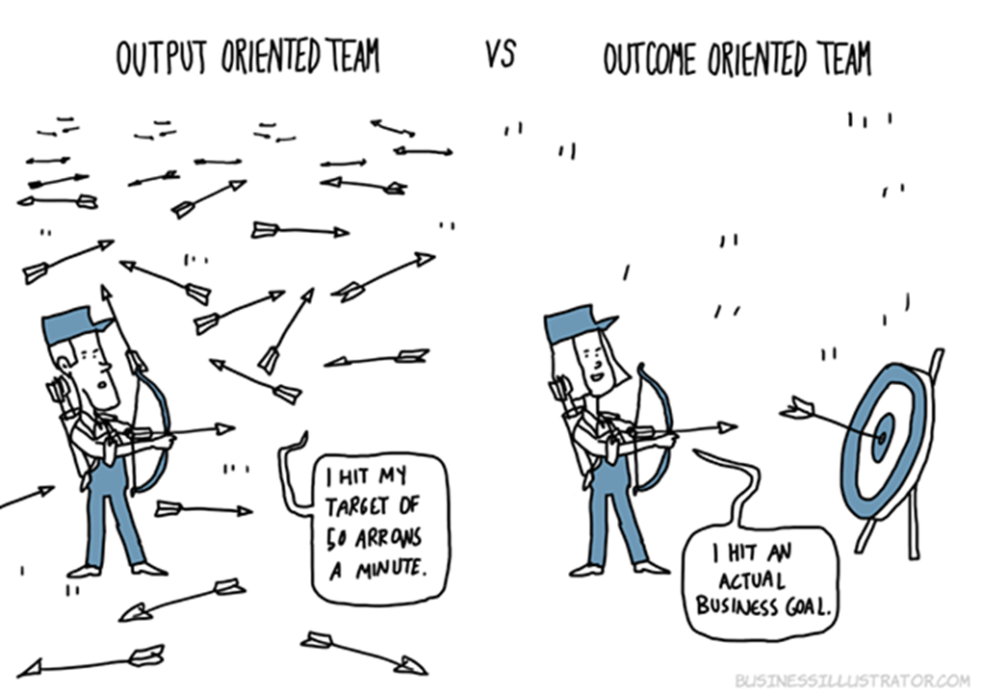
Result Framework
The Paradox of Success occurs when we recognize the need to change before we have to change

Slide 32


Thanks!
Flipcarbon Integrated CFO Solutions Private Limited
www.flipcarbon.com
Bangalore | Delhi | Mumbai | Chennai

